Slide 1
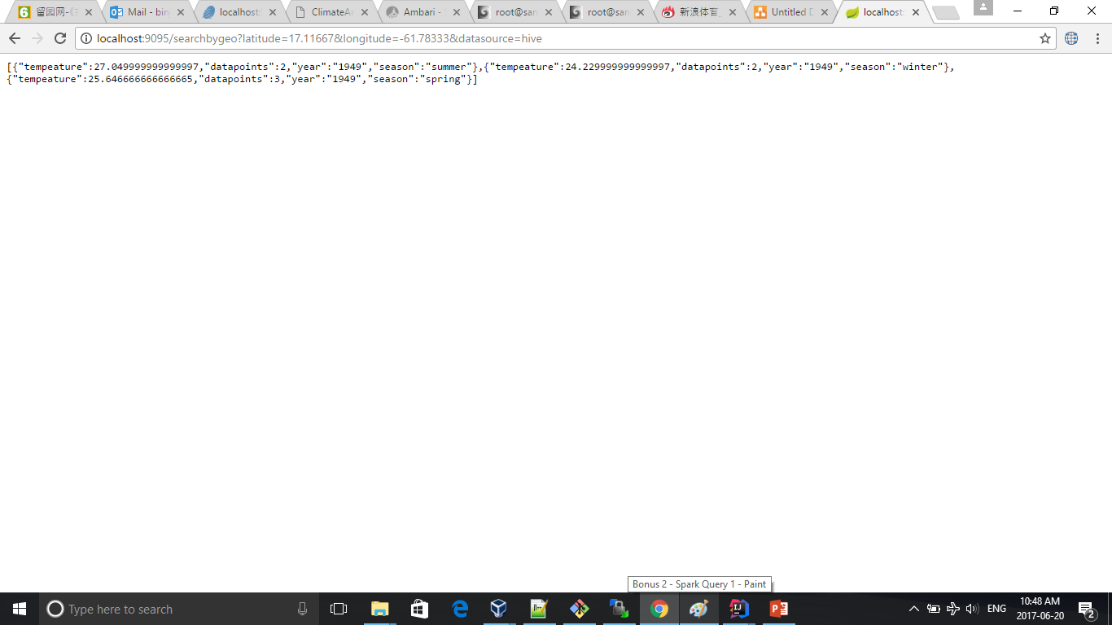
Bonus Question 1 – Hive Solution

Slide 2
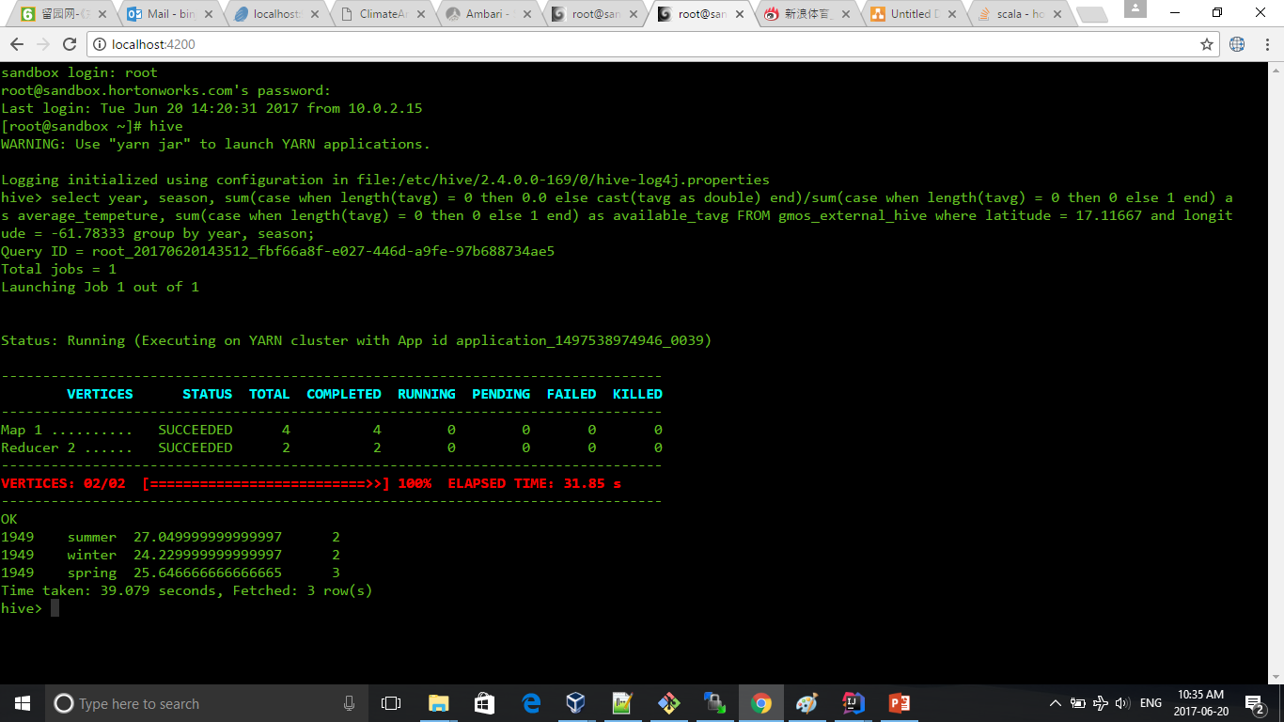
Bonus Question 1 – Hive Solution

Slide 3
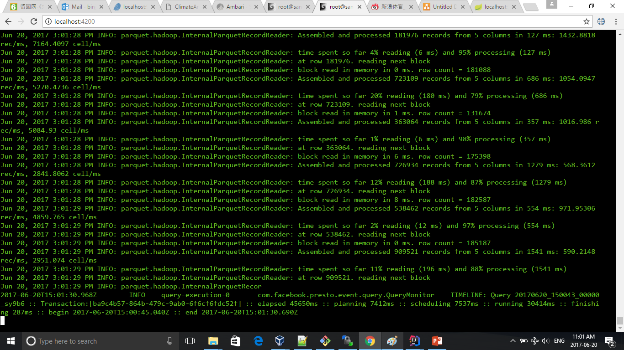
Bonus Question 1 – Presto Solution

Slide 4
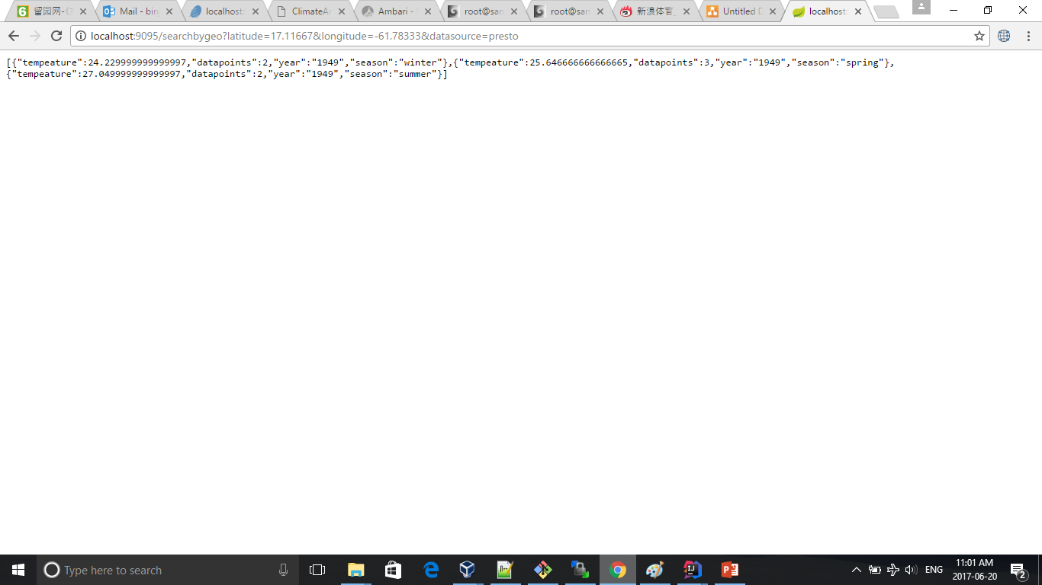
Bonus Question 1 – Presto Solution

Slide 5
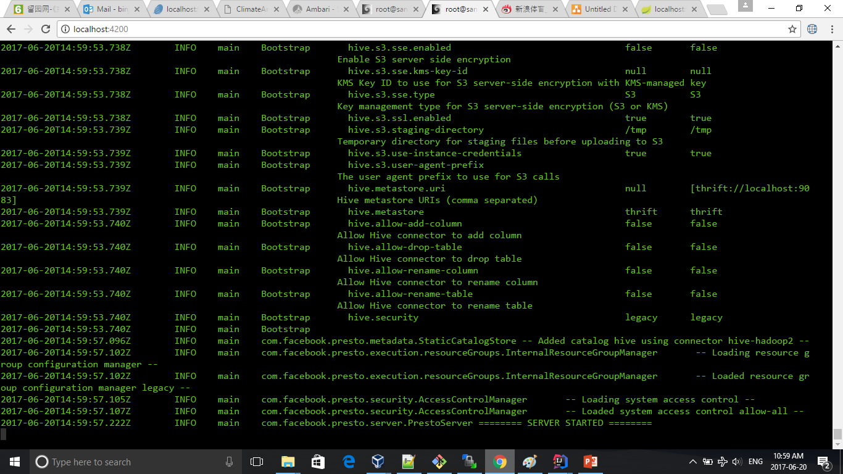
Bonus Question 1 – Presto Solution

Slide 6
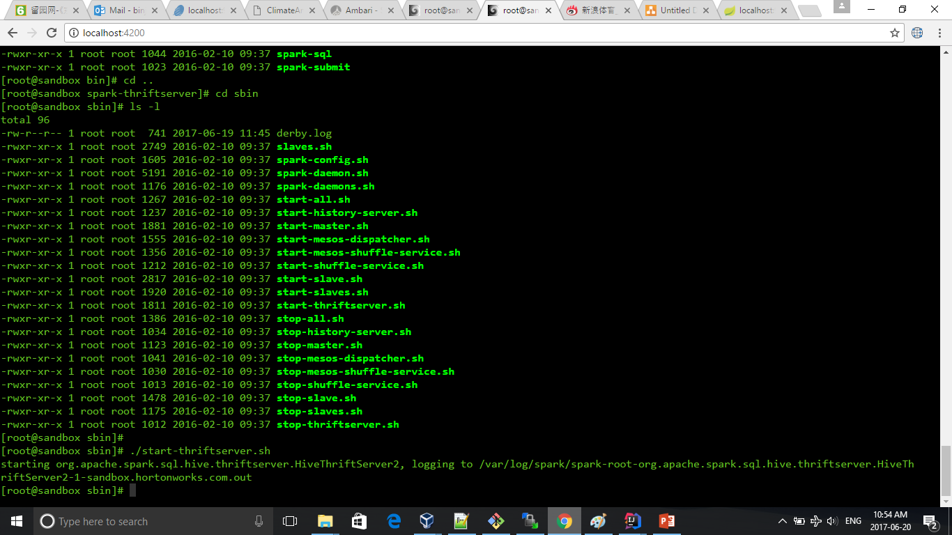
Bonus Question 1 – Spark Solution

Slide 7

Bonus Question 1 – Spark Solution

